Slide 1
solving the resistor ladder problem using matrix math
Wissam Razouki
CSE 3802

Slide 2
Introduction

Slide 3
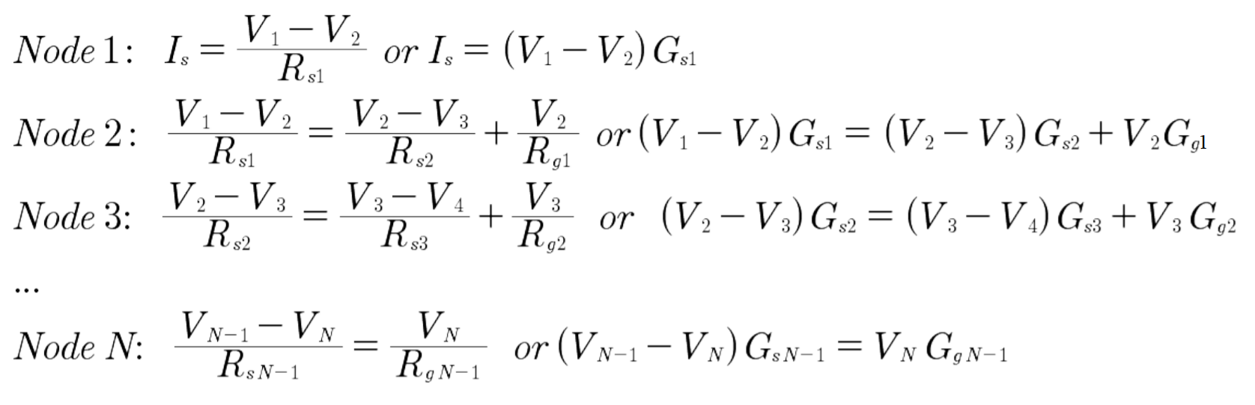

The Problem
The equations for solving for the voltages at each node for nodes 1 through $N$ in the resistor ladder are given as:
Where the current source $I_{s}$ and the resistor values $R_{s}$ and $R_{g}$ are known, and $G=\frac{1}{R}$.
In order to convert this linear system to matrix form, we must first rewrite the equations in the form $GV=I$.

Slide 4
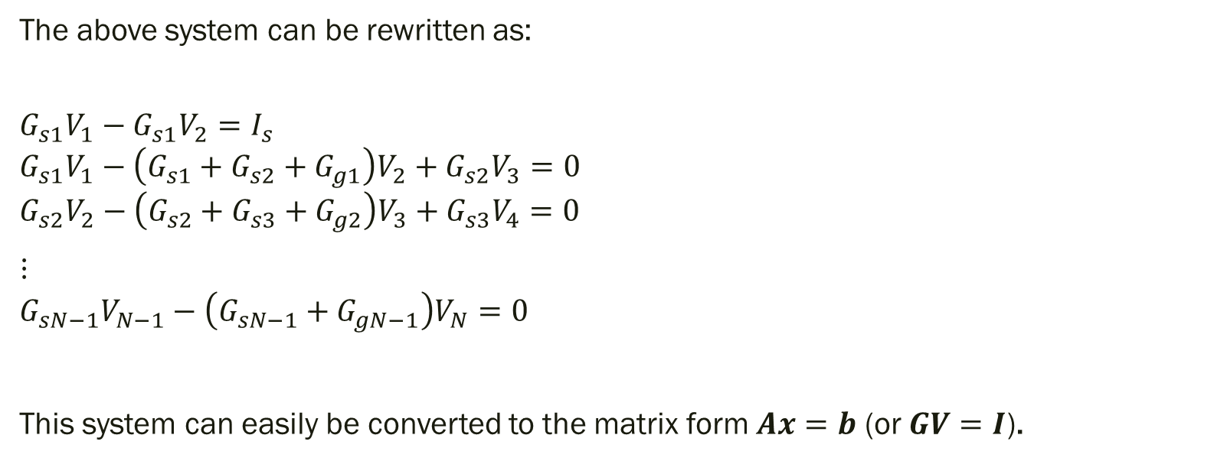
Rewritten Equations
The above system can be rewritten as:
$$G_{s1}V_{1}−G_{s1}V_{2}=I_{s}$$
$$G_{s1}V_{1}−\left(G_{s1}+G_{s2}+G_{g1}\right)V_{2}+G_{s2}V_{3}=0$$
$$G_{s2}V_{2}−\left(G_{s2}+G_{s3}+G_{g2}\right)V_{3}+G_{s3}V_{4}=0$$
⋮
$$G_{sN−1}V_{N−1}−\left(G_{sN−1}+G_{gN−1}\right)V_{N}=0$$
This system can easily be converted to the matrix form $Ax=b$ (or $GV=I$).

Slide 5
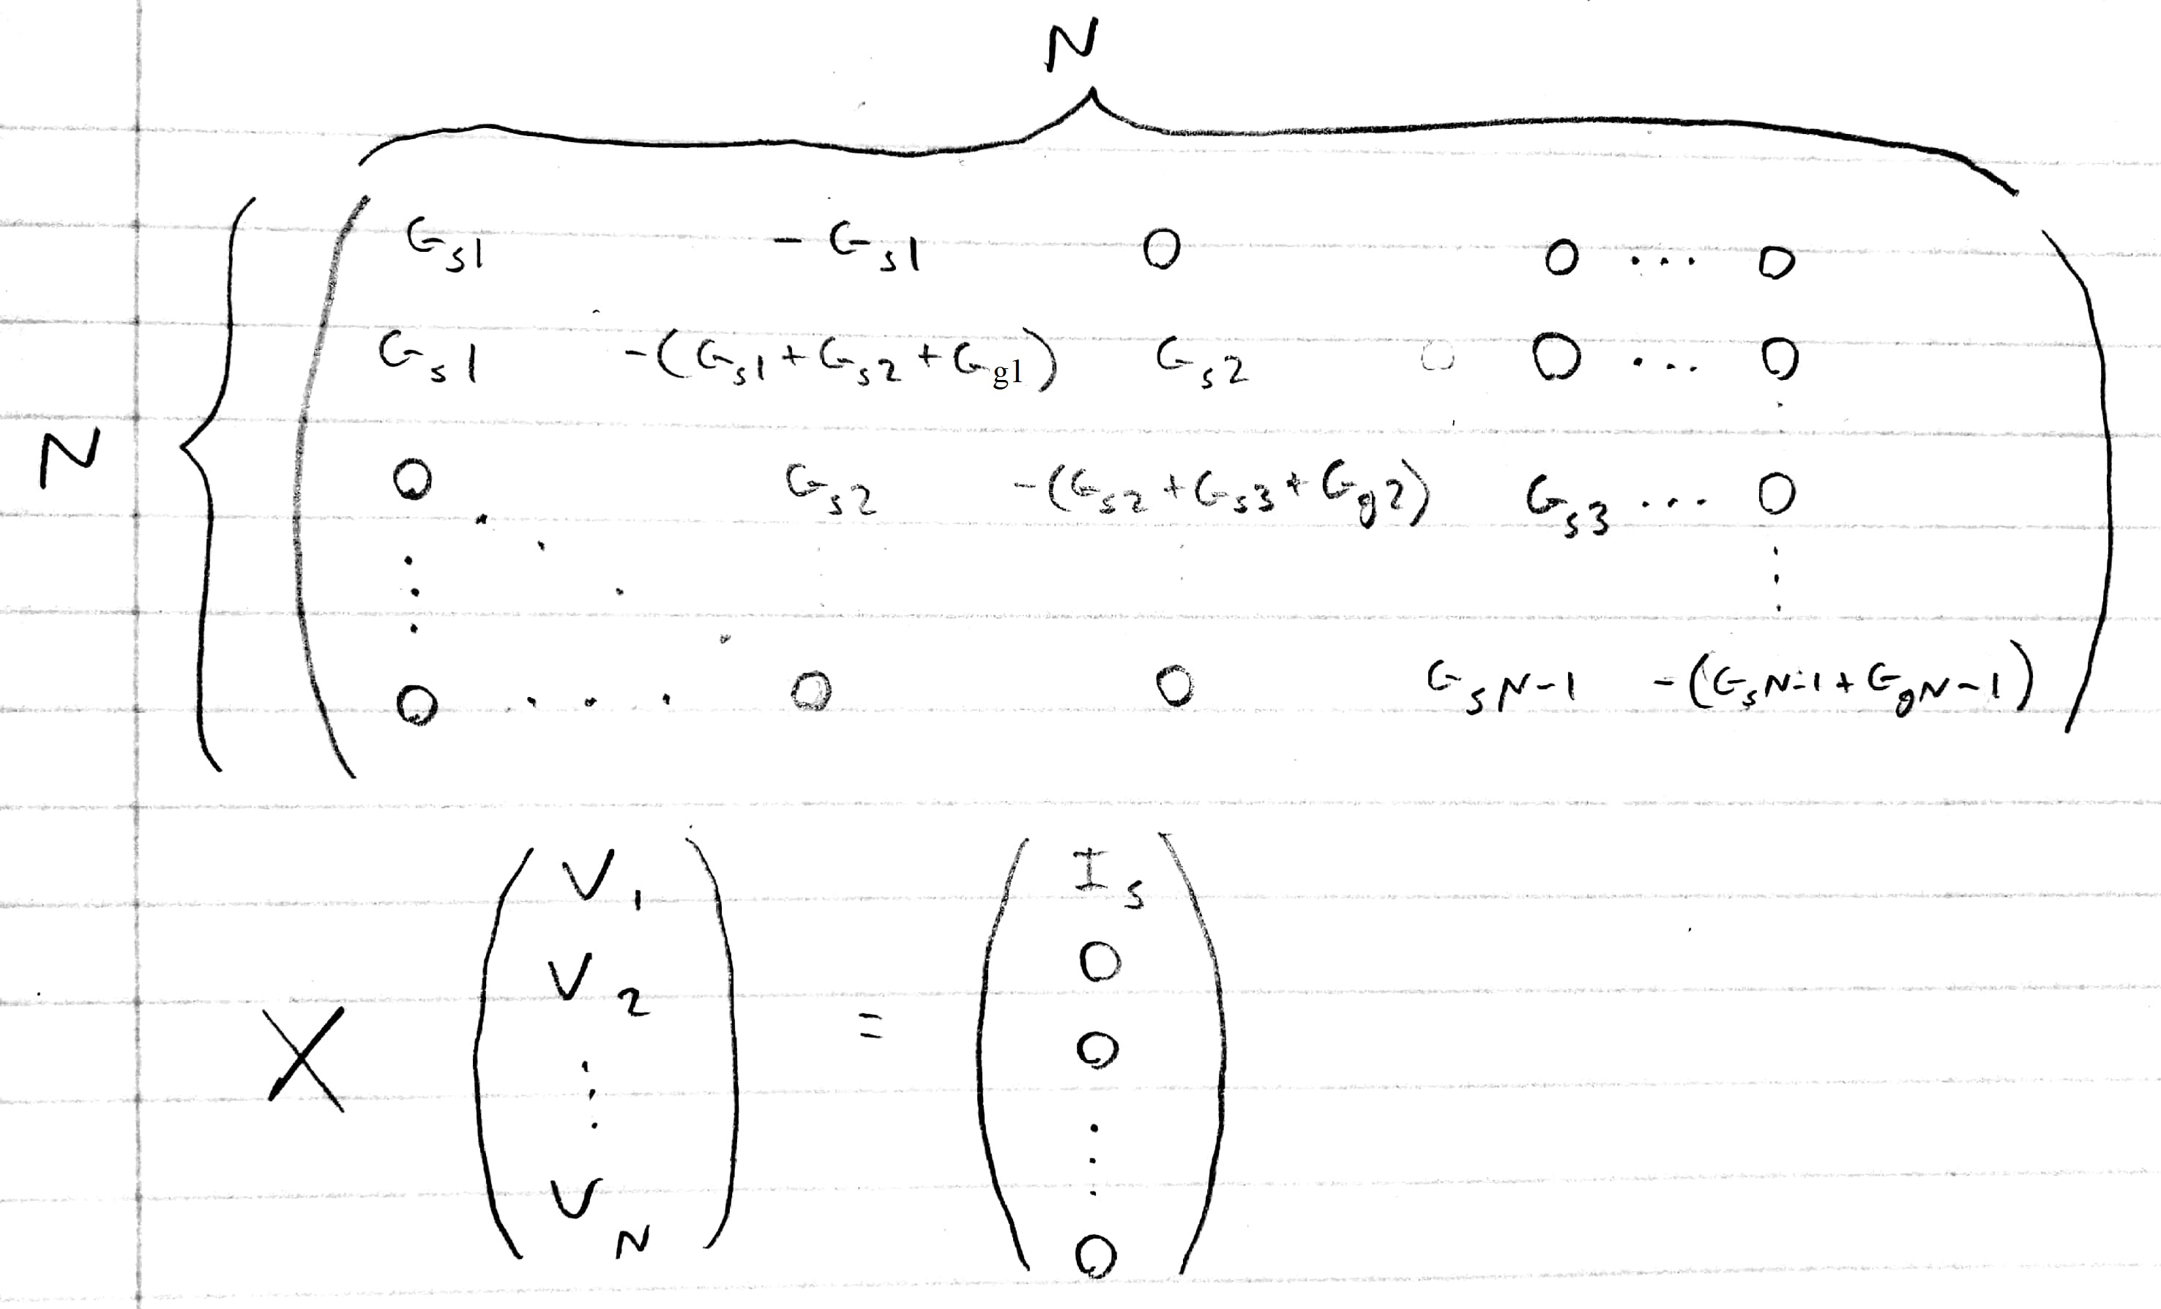
Resultant Matrix Form
Now that we have matrix $A$ and vector $b$, we can implement the solution methods for $x.$

Slide 6
Methods Used
Reference method:
Exact solution using MATLAB
Experimental method:
Jacobi iteration

Slide 7
Methods

Slide 8

The Exact Solution
MATLAB provides a direct solution to $x$ given $A$ and $b$. The command for this is: x = A\b.
We can use this to compare to our experimental method.

Slide 9
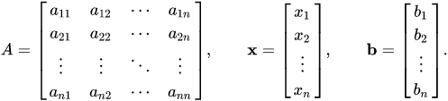
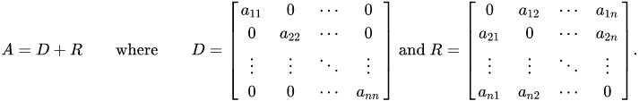
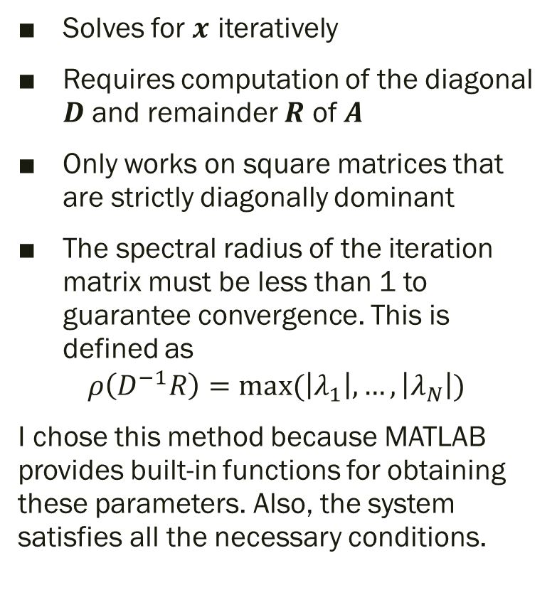
Jacobi Method
Solves for $x$ iteratively
Requires computation of the diagonal $D$ and remainder $R$ of $A$
Only works on square matrices that are strictly diagonally dominant
The spectral radius of the iteration matrix must be less than 1 to guarantee convergence. This is defined as
$$ρ\left(D^{−1}R\right)=max⁡(\left|λ_{1}\right|,…,\left|λ_{N}\right|)$$
I chose this method because MATLAB provides built-in functions for obtaining these parameters. Also, the system satisfies all the necessary conditions.
From Wikipedia

Slide 10
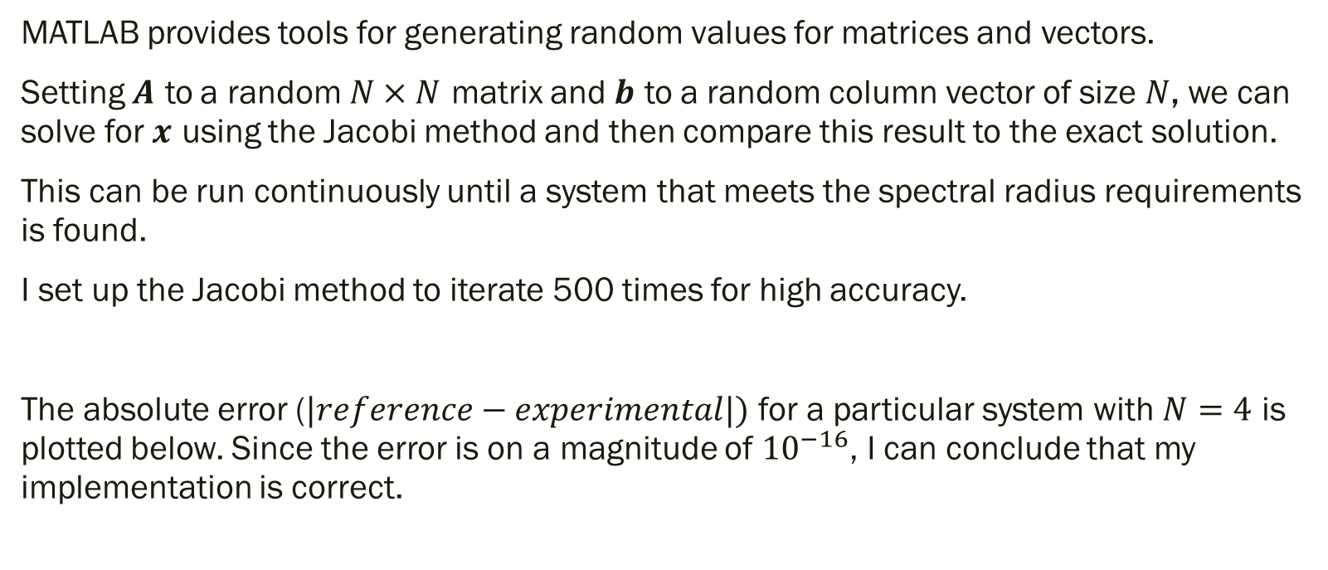
Method Verification
MATLAB provides tools for generating random values for matrices and vectors.
Setting $A$ to a random $N×N$ matrix and $b$ to a random column vector of size $N$, we can solve for $x$ using the Jacobi method and then compare this result to the exact solution.
This can be run continuously until a system that meets the spectral radius requirements is found.
I set up the Jacobi method to iterate 500 times for high accuracy.
The absolute error ($|reference−experimental|)$ for a particular system with $N=4$ is plotted below. Since the error is on a magnitude of ${10}^{−16}$, I can conclude that my implementation is correct.

Slide 11
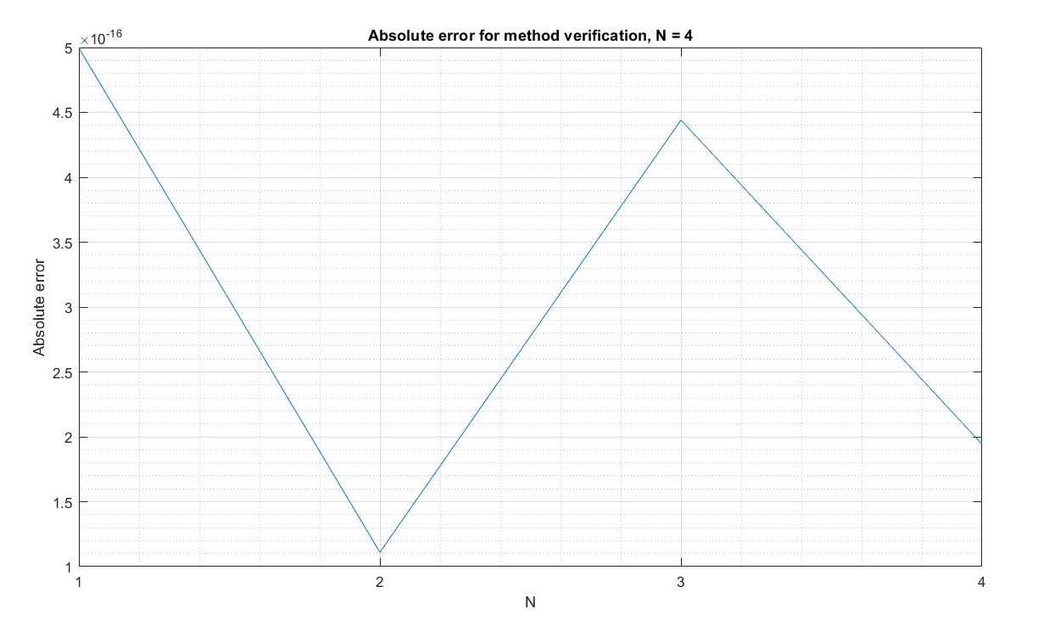

Slide 12
Solutions: case 1 and case 2

Slide 13
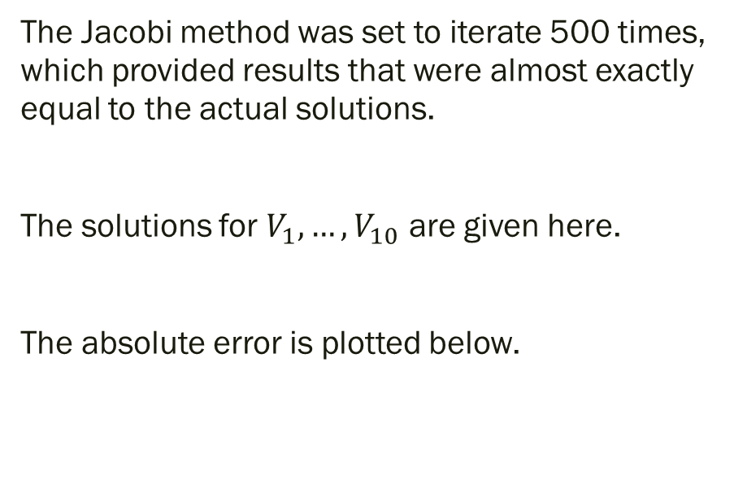
Case 1
Voltage (V)
869.4368
69.4368
8.3104
1.3392
0.2659
0.0641
0.0217
0.0124
0.0105
0.0102
The Jacobi method was set to iterate 500 times, which provided results that were almost exactly equal to the actual solutions.
The solutions for $V_{1},…,V_{10}$ are given here.
The absolute error is plotted below.

Slide 14
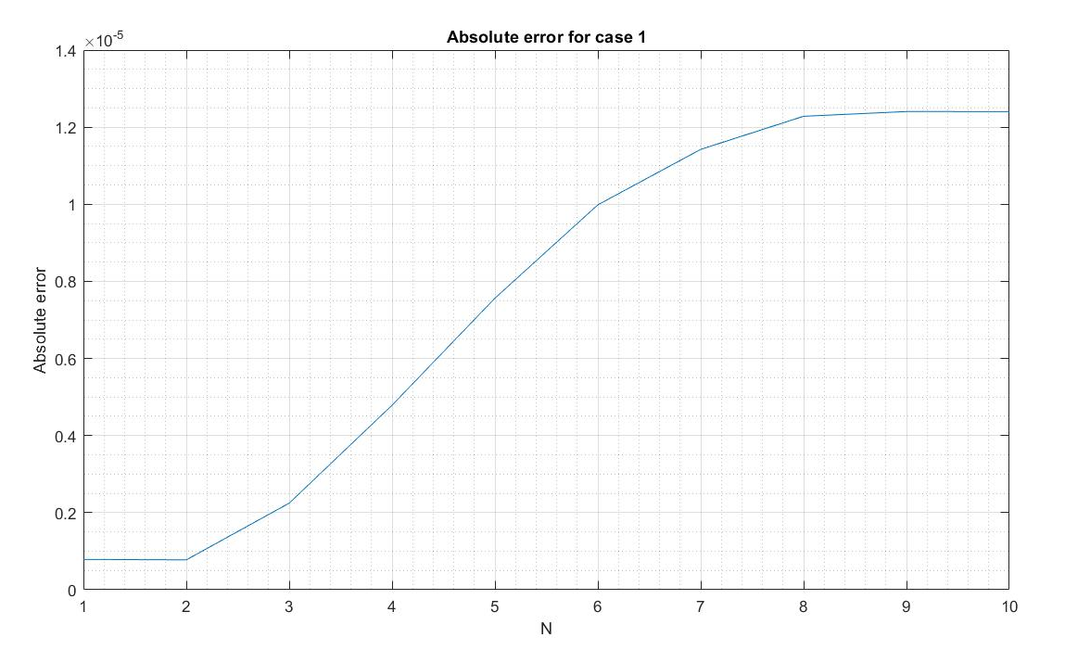

Slide 15
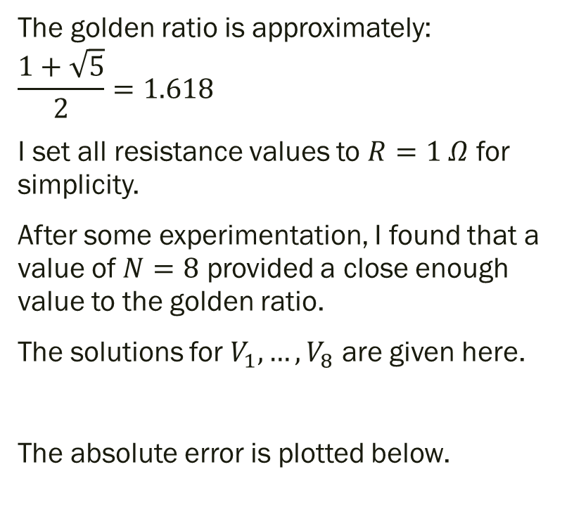
Case 2
Voltage (V)
1.6180
0.6180
0.2361
0.0902
0.0345
0.0133
0.0053
0.0027
The golden ratio is approximately:
$$\frac{1+\sqrt{5}}{2}=1.618$$
I set all resistance values to $R=1 Ω$ for simplicity.
After some experimentation, I found that a value of $N=8$ provided a close enough value to the golden ratio.
The solutions for $V_{1},…,V_{8}$ are given here.
The absolute error is plotted below.

Slide 16
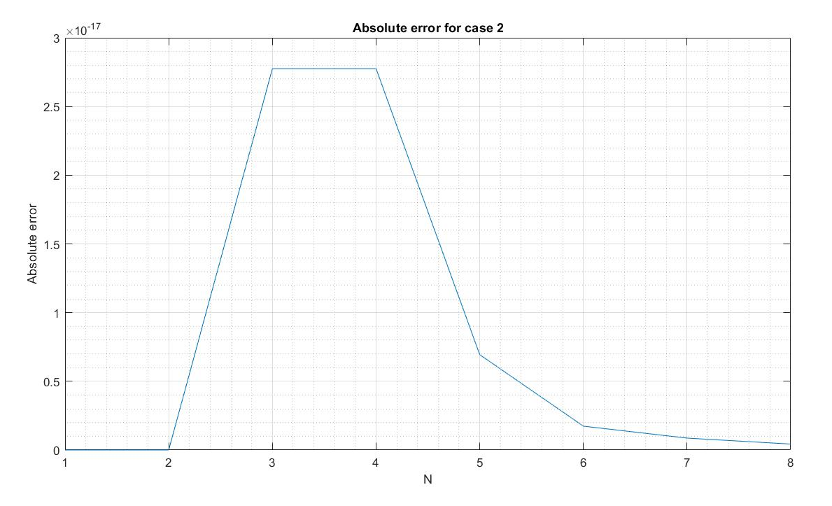

Slide 17
conclusions

Slide 18
Analysis and Conclusions
From these results, we can see that the Jacobi method provides very accurate solutions when it is set up to iterate many times.
However, the conditions (square matrix, spectral radius, etc.) are strict. If they are not met, the results could be very inaccurate or the method could fail entirely
Because this particular problem satisfies all conditions, no errors were met
But there are many conditions where my code fails to solve the problem. Given a system with either:
A non-square matrix
An iteration matrix with a spectral radius of greater than 1
A matrix that is not strictly diagonally dominant
the Jacobi method could fail to give an accurate result

